Slide 1
QUEUES
CICS Training Class-07

Slide 2
Introduction to QUEUE’S
Queue’s are temporary storages for holding up records that need to be processed. They are not physically stored.
The processing is much faster for the queues as they are available readily in main memory
There are two types of queues :
      Temporary Storage Queue (TSQ)
      Transient Data Queue (TDQ)

Slide 3
Temporary Storage Queue
TSQ’S provides application programmer the ability to store and retrieve data.
Application can use TSQ like a scratch pad
TSQ are:
  Created and deleted dynamically
  No CICS table entry required (if recovery NOT required)
  Identified by queue id ( 1 to 8 bytes)
Each record in TSQ identified by relative position called the Item Number

Slide 4
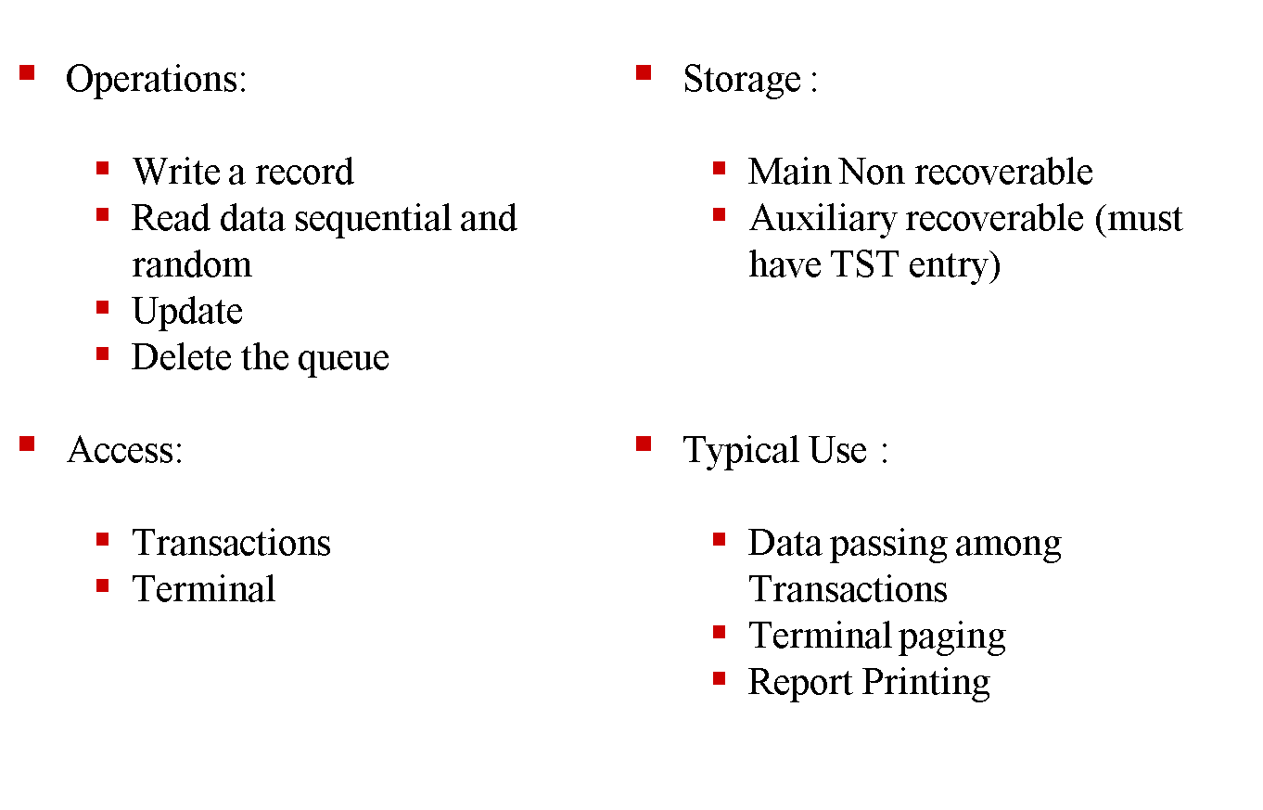
More about TSQ

Slide 5
WRITEQ TS
      EXEC CICS WRITEQ TS
        QUEUE(Q NAME)
        FROM(DATA-AREA)
        LENGTH(DATA-VALUE)
        ITEM(DATA-AREA) | REWRITE
        MAIN | AUXILARY
      END-EXEC.
Conditions : ITEMERR, LENGERR, QIDERR, NOSPACE, NOTAUTH

Slide 6
ReadQ TS
        EXEC CICS READQ TS
        QUEUE(Q NAME)
        INTO(DATA-AREA)
        LENGTH(DATA-VALUE)
        ITEM(DATA-AREA) | NEXT
        END-EXEC.
Conditions : ITEMERR, LENGERR, QIDERR, NOTAUTH

Slide 7
Deleteq ts
Delete’s the queue.
      EXEC CICS DELETEQ TS
        QUEUE(Q NAME)
      END-EXEC
Conditions : QIDERR, INVREQ

Slide 8
Transient data queue
TDQ provides the programmer with queuing facilities
Data can be stored for internal/external processing
Stored data can be routed to symbolic destination
TDQs require DCT entry
Identified by destination ID 1 to 4 bytes

Slide 9
Intra and extra partitioned TDQs
INTRA partitioned: associated with the same CICS subsystem.
  Typical uses:
      ATI (Automatic task initiation ) associated with trigger level
      Message switching
Extra Partitioned: associated with internal/external cics, to any sequential dives like DASD TAPE
  TYPICAL USES :
      Logging data, transaction error messages storing
Operations:
  Write a record
  Read data sequential
  Delete the queue

Slide 10
Automatic Task Initiation
ATI is the facility through which a CICS transaction can be initiated automatically.
DFHDCT TYPE=INTRA,
DESTID=MSGS,
TRANSID=MSG1,
TRIGLEV=500
When the number of record reaches 500, the transaction MSG1 will be initiated automatically.

Slide 11
WRITEQ TD
      EXEC CICS WRITEQ TD
        QUEUE(Q NAME)
        FROM(DATA-AREA)
        LENGTH(DATA-VALUE)
        ITEM(DATA-AREA)
      END-EXEC.
Conditions : ITEMERR, LENGERR, QIDERR, NOSPACE, NOTAUTH

Slide 12
READQ TD
        Reads the queue distractively, record is not available in the queue after the read.
        EXEC CICS READQ TD
        QUEUE(Q NAME)
        INTO(DATA-AREA)
        LENGTH(DATA-VALUE)
        NEXT
        END-EXEC.
Conditions : QZERO, LENGERR, QIDERR, NOTAUTH

Slide 13
DELETEQ TD
Delete’s the queue
      EXEC CICS DELETEQ TD
        QUEUE(Q NAME)
      END-EXEC
Conditions : QIDERR, NOTAUTH , INVREQ

Slide 14
Differences between TSQ's and TDQ's.
In TSQ, data can be written and read either sequentially or randomly, while
in TDQ, the data is written or read only sequentially.
Data can be updated in place for TSQ, but not in TDQ.
In TSQ, the data can be read any number of times because it remains in the
queue until the entire queue is deleted. In a TDQ data item, it is read only
once.
TSQ does not use a trigger level while TDQ data has a trigger level
(automatic task initiation).
The TSQ name is defined dynamically, while a TDQ name is defined in the
DCT. TSQ can be written to auxiliary or main storage, while TDQ is
written to disk.

Slide 15
Thank You
Polsani Anil Kumar

